Slide 1

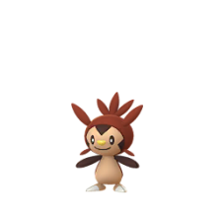
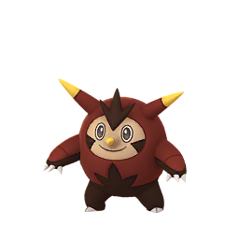
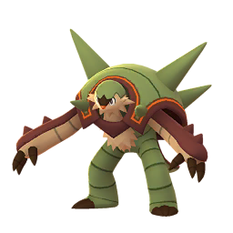
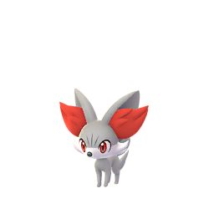
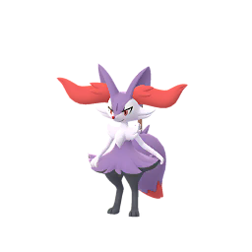
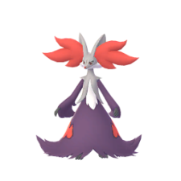

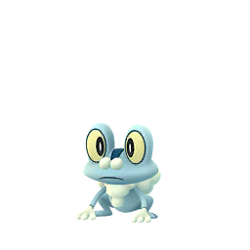
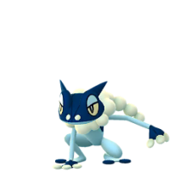
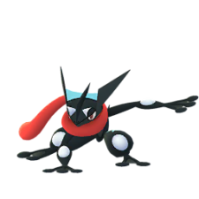
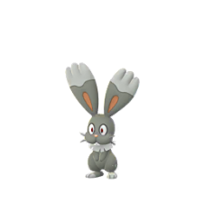
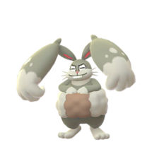
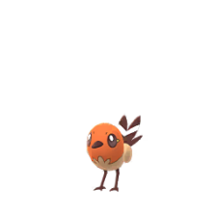
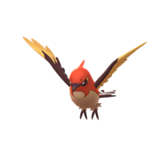
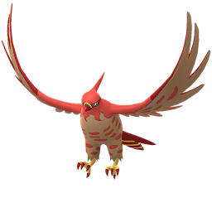
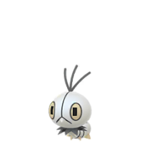
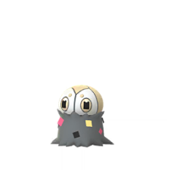
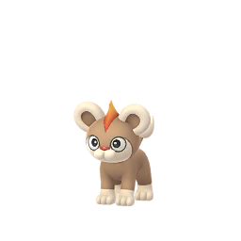
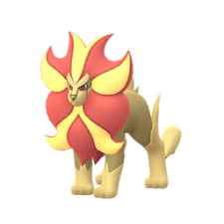
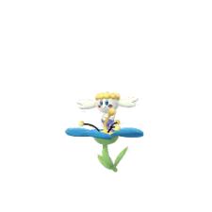
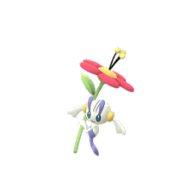
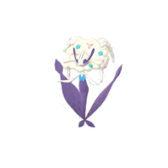
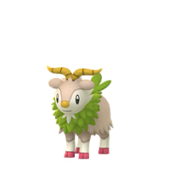
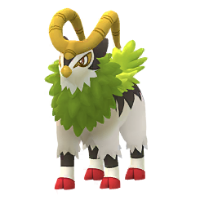
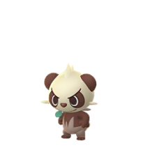
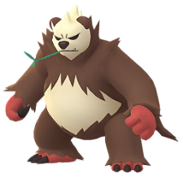
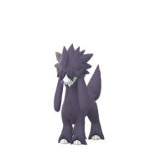
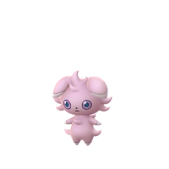
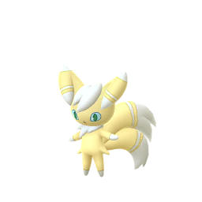
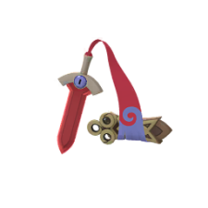
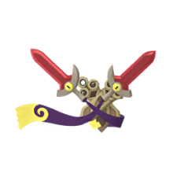
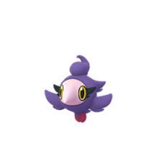
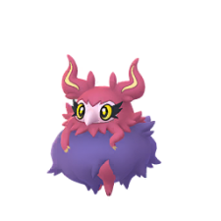
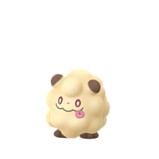

Pokemon Go : Shiny Check List
Generation 6 ( Kalos )
Chespin
Quilladin
Chesnaught
Fennekin
Braixen
Delphox
Froakie
Frogadier
Greninja
Bunnelby
Diggersby
Fletchling
Fletchinder
Talonflame
Scatterbug
Spewpa
Vivillon
Litleo
More On Page 3
NO SPRITE
Pyroar
Flabebe
Floette
Florges
Skiddo
Gogoat
More On Page 4
More On Page 4
More On Page 4
Pancham
Pangoro
Furfrou
Espurr
Meowstic
Honedge
More On Page 4
Doublade
Aegislash
Spritzee
Aromatisse
Swirlix
Slurpuff
NO SPRITE
Page 1 of 5

Slide 2
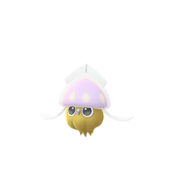
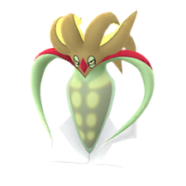
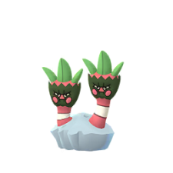
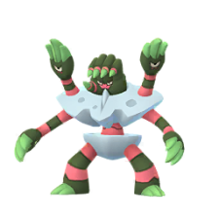
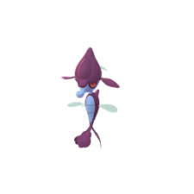
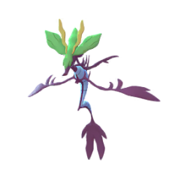
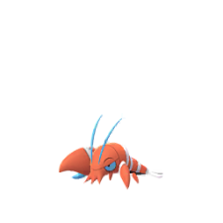
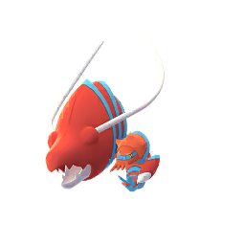
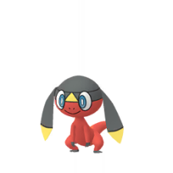
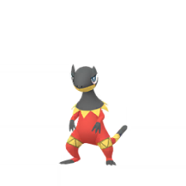
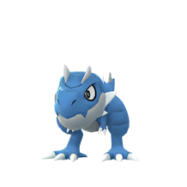
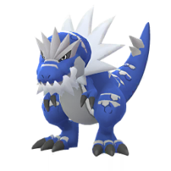
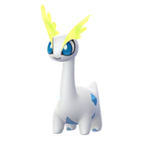
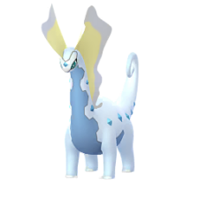
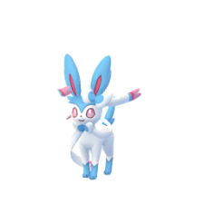
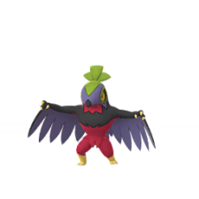

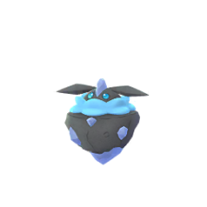















Pokemon Go : Shiny Check List
Generation 6 ( Kalos )
Inkay
Malamar
Binacle
Barbaracle
Skrelp
Dragalge
Clauncher
Clawitzer
Helioptile
Heliolisk
Tyrunt
Tyrantrum
Amaura
Aurorus
Sylveon
Hawlucha
Dedenne
Carbink
Goomy
Sliggoo
Goodra
Klefki
Phantump
Trevenant
Hisuian On Page 5
Hisuian On Page 5
Pumpkaboo
Gourgeist
Bergmite
Avalugg
Noibat
Noivern
Hisuian On Page 5
More On Page 5
More On Page 5
Xerneas
Yveltal
Zygarde
Diancie
Hoopa
Volcanion
More On Page 3
MEGA On Page 3
More On Page 3
NO SPRITE
NO SPRITE
NO SPRITE
Page 2 of 5

Slide 3
Pokemon Go : Shiny Check List
Generation 6 ( Kalos )
Other’s
Vivillon Pattern’s
Archipelago
Continental
Elegant
Fancy
Garden
High Plains
NO SPRITE
NO SPRITE
NO SPRITE
NO SPRITE
NO SPRITE
NO SPRITE
Icy Snow
Jungle
Marine
Meadow
Modern
Monsoon
NO SPRITE
NO SPRITE
NO SPRITE
NO SPRITE
NO SPRITE
NO SPRITE
Ocean
Poke Ball
Polar
River
Sandstorm
Savanna
NO SPRITE
NO SPRITE
NO SPRITE
NO SPRITE
NO SPRITE
NO SPRITE
Sun
Tundra
MEGA
NO SPRITE
NO SPRITE
Diancie
NO SPRITE
Zygarde Forme
Hoopa
10%
50%
Complete
Confined
Unbound
NO SPRITE
NO SPRITE
NO SPRITE
NO SPRITE
Page 3 of 5

Slide 4





















Pokemon Go : Shiny Check List
Generation 6 ( Kalos )
Other’s
Flabebe, Floette & Florges Flower Dream
Blue
Orange
Red
White
Yellow
Blue
Orange
Red
White
Yellow
Blue
Orange
Red
White
Yellow
Furfrou Trim’s
Natural
Dandy
Deputante
Diamond
Heart
Kabuki
La Reine
Matron
Pharaoh
Star Trim
Page 5 of 5

Slide 5









Pokemon Go : Shiny Check List
Generation 6 ( Kalos )
Other’s & Hisuian
Pumpkaboo & Gourgeist
Normal
Small
Average
Large
Super
Normal
Small
Average
Large
Super
Hisuian
Sliggoo
Goodra
Avalugg
NO SPRITE
NO SPRITE
NO SPRITE
Page 5 of 5

